Slide 1
WE ARE ALL
TREATY PEOPLE
Notes:
Photo: open source

Slide 2
Analyze
CAUSE &
CONSEQUENCE
In examining both tragedies and accomplishments in the past, we are usually interested in the questions of how and why. These questions start the search for causes: what were the actions, beliefs, and circumstances that led to these consequences?
We need to consider human agency. People, as individuals and as groups, play a part in promoting, shaping, and resisting change. People have motivations and reasons for taking action, but causes go beyond these.
Notes:
The 6 Thinking Hats of Historical Thinking

Slide 3
“We had our own government and laws before the arrival of Europeans, and we lived in harmony with Mother Earth. We signed the Treaty to live in harmony with the people of Canada and their government. To us, this makes all the people of Canada Treaty people, just as we are. The Treaty is forever: for as long as the grass grows, the water flows and the wind blows.”
-Elder Bruce Starlite, Tsuu T’ina First Nation

Slide 4
Treaty No.9 Commission, Commissioners land and Long Lake, ON. 1906
WE ARE ALL TREATY PEOPLE
TREATIES IN CANADA
Notes:
Photo: Treaty No.9 Commission, Commissioners land and Long Lake, ON. 1906. (From the Archives of Matawa First Nations)

Slide 5
WE ARE ALL TREATY PEOPLE
TREATIES IN CANADA
Prior to contact, North America, was populated by many nations with rich languages, cultures, religions, and sophisticated ways of life and traditional territories.
A key component of Indigenous governance and law-making was entering in to treaties. These alliances established peaceful relationships among them which included trade, safe passage, peace, respect and other other obligations outlined in the Treaties.
Snowy Owl Whitecotton, with his daughter and his wife Leah Beaver (1906)
Notes:
Watch the Youtube video ‘Trick or Treaty?’ here: https://www.youtube.com/watch?v=g34Ty0nH8O8
Photo: Snowy Owl Whitecotton, Native American photo Sampson Beaver with his daughter, Frances Beaver, and his wife Leah Beaver - Assiniboine - 1906

Slide 6
WE ARE ALL TREATY PEOPLE
FIRST NATIONS TREATY
MAKING
First Nations had their own process of Treaty-making that had existed for thousands of years.
The ceremony and the items used within the First Nations’ Treaty-making process differed from culture to culture, but it followed the general format of: introductions, gift-giving, time spent getting to know each other, negotiations and the formalization of the Treaty through a pipe ceremony. After the pipe ceremony, the Treaty would then be seen as a tri-party agreement between the two parties and the Creator.
First Nations continued their custom of Treaty-making with Europeans when they arrived, as they valued peace over war and conflict.
The Great Peace Treaty of Montréal, by Francis Back.
Notes:
Photo:: Depiction of the assembly of the 4th of August 1701, before the signature of the ‘Grande Paix de Montréal’ or the Great Peace Treaty of Montreal by artist Francis Back.

Slide 7
Meeting for Treaty 6 (1876)
WHAT DO TREATIES REPRESENT IN CANADA?
Negotiated rights between then Crown (Federal Government) and First Nations peoples. It is a legal agreement that exists between the Crown and First Nation peoples, and is recognized by the supreme Court of Canada.
Each group trusting the other will fulfill their obligations as stated in the Treaty.
Notes:
Photo: Meeting for Treaty 6, 1876 (Glenbow Archives Na-448-6)

Slide 8
WE ARE ALL TREATY PEOPLE
TYPES OF TREATIES
Peace and Friendship Treaties
3. Pre-Confederation Treaties
2. Post-Confederation
(Numbered) Treaties
4. Modern Treaties
Notes:
Photos: 1.Depiction of the assembly of the 4th of August 1701, before the signature of the ‘Grande Paix de Montréal’ or the Great Peace Treaty of Montreal by artist Francis Back.; 2. Meeting for Treaty 6 (Glenbow Archives Na-448-6); 3. Indian Chiefs Medal, Presented to commemorate Treaty Numbers 3, 4, 5, 6, 7, 8 (Queen Victoria). Image courtesy of Library and Archives Canada Library and Archives Canada, Acc. No. 1964-1-1M.; 4. Prime Minster Stephen Harper shakes hands with Chief Wilson Littlechild after reading the Government of Canada’s Official Apology on the floor of the Parliament building. (THE CANADIAN PRESS/Fred Chartrand)

Slide 9
CHARACTERISTICS OF A VALID TREATY
Parties: Crown/First Nation
Agency: Whoever signs the treaty must have authority to bind the parties.
Intention: Parties must intend to create legally binding obligations.
Consideration: Obligations by both sides to fulfill.
Formality: A measure of solemnity (seriousness) to the signing and intent.
Two Row Wampum Treaty Belt
Notes:
Photo: Wampum Treaty Belt (courtesy of Productions Cazabon)

Slide 10
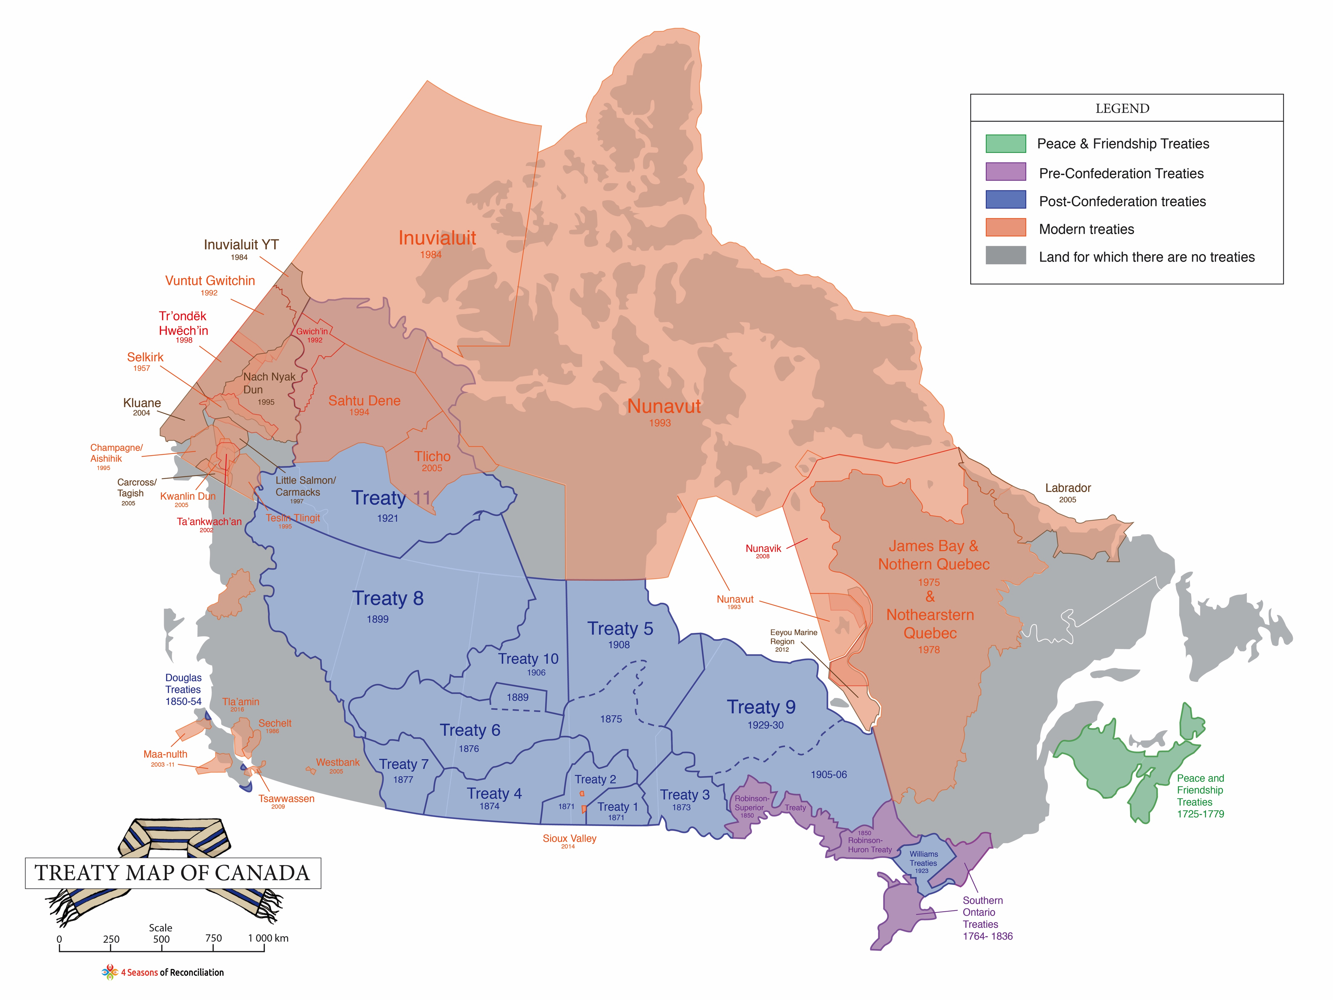

Slide 11
WE ARE ALL TREATY PEOPLE
PEACE & FRIENDSHIP
TREATIES
Signed during the 17th and 18th centuries with the French, Dutch and English.
Guarantee of hunting and fishing rights in return for peaceful relationships and military alliances.
No land cession, but still valid.
Printed Proclamation of the 1752 Peace and Friendship Treaty
Notes:
Photos: Printed Proclamation of the 1752 Treaty (Peace and Friendship Treaties Nova Scotia Archives RG 1, Vol. 430, No. 2)

Slide 12
WE ARE ALL TREATY PEOPLE
PRE-CONFEDERATION TREATIES
The Royal Proclamation was issued by Britain's King George III in 1763 after the victory over the French in the Seven Years War. The Proclamation established the constitutional framework for the negotiation of treaties with Indigenous peoples who inhabited British controlled North America. It was at the time a significant acknowledgement of the power of Indigenous nations.
A common myth is that Indigenous people lost the war against Europeans.
The truth remains that the Europeans feared the impacts of Indigenous unrest on their North American territories and felt it wise to appease the Indigenous Nations by reassuring them of land rights.
Indian Chiefs Medal, Presented to commemorate Treaty Numbers 3, 4, 5, 6, 7, 8
Notes:
Photo: Indian Chiefs Medal, Presented to commemorate Treaty Numbers 3, 4, 5, 6, 7, 8 (Queen Victoria). Image courtesy of Library and Archives Canada Library and Archives Canada, Acc. No. 1964-1-1M.

Slide 13
WE ARE ALL TREATY PEOPLE
THE IMPORTANCE OF TREATIES FOR EUROPEANS
Colonies in the vastness of North America could only be successful in their wars against each other if Indigenous People fought at their side. Without these alliances Canada would not be a country today; it would most likely be part of the United States.
The Oneidas at the Battle of Oriskany," by Don Troiani
Unbeknownst to the majority of Canadians, we owe our Nationhood and to the Indigenous soldiers who ensured a successful victory in the war of 1812 against what is the United States today.
Indigenous Nations and their sophisticated warring tactics helped win the territory we call Canada through the brotherhood and loyalty founded by the Treaties.
Indigenous People and Treaties were instrumental in giving birth to Canada.
"Battle of Tippecanoe" by Kurz & Allison
Notes:
Photo bottom right: "The Oneidas at the Battle of Oriskany," by noted historical artist Don Troiani. The painting depicts one of the bloodiest battles of the Revolutionary War, with an emphasis on the Oneidas who fought alongside the colonists as the United States' first allies against the British.
Photo top left: "Battle of Tippecanoe" by Kurz & Allison (detail) American troops under the leadership of General William Henry Harrison fighting the Indian forces of The Prophet, Tenskwatawa (the brother of Tecumseh) in a forest. Source: Libary of Congress

Slide 14
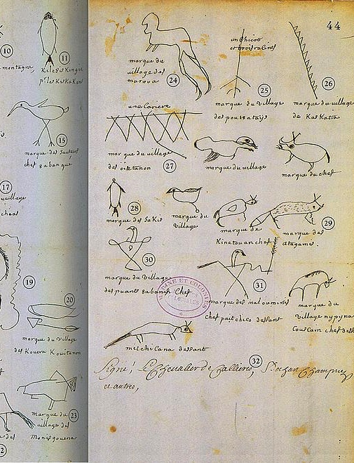
SIR WILLIAM JOHNSON
British Advisor to the Board of Trade, 1764
“The Indians all know we cannot be a Match for them in the midst of an extensive woody Country...from whence I infer that if we are determined to possess Our Posts, Trade & camps securely, it cannot be done for a Century by any other means than that of purchasing the favour of the numerous Indian inhabitants.”
The Great Peace Treaty of Montreal with the signatures of over 40 Indigenous Nations
Notes:
Background photo: the Great Peace Treaty of Montreal with the signatures of over 40 Indigenous Nations. (Archives Nationales de France, Fonds des Colonies, correspondance générale, séries C11A, vol 19 (fo 41-44)).

Slide 15
WE ARE ALL TREATY PEOPLE
POST-CONFEDERATION TREATIES
It was on the basis of the Royal Proclamation of 1763 that Canada sought to sign the Numbered Treaties between 1871 and 1921.
The Proclamation recognized First Nation occupation and use of territories.
It also established the ‘Trust Relationship’ between the Crown and First Nations by stating that only the Crown could ‘purchase’ the land from the First Nations.
Violations against the Treaties continue to this day.
Notes:
Photo: Depiction of the assembly of the 4th of August 1701, before the signature of the ‘Grande Paix de Montréal’ or the Great Peace Treaty of Montreal by artist Francis Back. Seen center, Grand Chief Kondiaronk or the Huron-Wendats

Slide 16
Treaty No. 2 Document
HISTORIC OR
NUMBERED TREATIES
Between 1871 and 1921, the Crown entered into Treaties with various First Nations that enabled the Canadian government to actively pursue agriculture, settlement, transportation links and resource development of the Canadian West and the North.
Chiefs of the Six Nations at Brantford, ON and
their wampum belts (1871)
Because they were numbered 1 to 11, these Treaties were often referred to as the ‘Numbered Treaties’ and covered northern Ontario, Manitoba, Saskatchewan, Alberta, north-eastern British Columbia, and the Northwest Territories.
Notes:
Photo top: Treaty No. 2 (Library and Archives Canada)
Photo bottom: Chiefs of the Six Nations at Brantford, Canada, explaining their wampum belts to Horatio Hale September 14, 1871

Slide 17
WE ARE ALL TREATY PEOPLE
MODERN TREATIES
James Bay and Northern Quebec Agreement, 1976
Nunavut Agreement, 1993
Dogrib Claim, 2003
The Agreement Between the Inuit of the Nunavut Settlement Area and Her Majesty the Queen in right of Canada. 1993.
Notes:
Photo: cover of the Agrement Between the Inuit of the Nunavut Settlement Area and Her Majesty the Queen in right of Canada. 1993.

Slide 18
WE ARE ALL TREATY PEOPLE
PRINCIPLES OF INTERPRETATION
A treaty represents an exchange of solemn promises between the Crown and Indigenous nations and the nature of this agreement is sacred.
Ambiguities and doubtful expressions in older treaties must be resolved peacefully and in court of law.
‘Honor The Treaties’, Ernesto Yerena (2010)
Notes:
Photo: ‘Honor The Treaties’ post by Ernesto Yerena. Honor the Treaties was created in 2010 (as the result of a TED talk by Aaron Huey, and collaborations with Shepard Fairey and Ernesto Yerena) as an art experiment to educate the public about Native American Treaty Issues.

Slide 19
Indigenous Peoples receiving treaty money, 1930
WE ARE ALL TREATY PEOPLE
CONCLUSION
TREATIES ARE LEGAL CONTRACTS
British common law and traditional perceptions of order would demand that these rights and benefits be guaranteed by the British Crown through the Canadian government
A source of tension between the First Nations and the Federal government stems from conflicting beliefs about the legal/moral obligations of these treaties.
Notes:
Photo: Indigenous Peoples receiving treaty money, 1930. (Courtesy Library and Archives Canada/MIKAN 3348407)

Slide 20
“Most important, treaties are about relationships. They are not just a form of covenant or contract that lives in perpetuity.
They are agreements of honour and respect that define the relationship between First Nations and the government of Canada.”
-JAMES WILSON,
Commissioner of Treaty Relations
Commission of Manitoba
Members of the Musqueam First Nation paddle a traditional canoe, Darryl Dyck (2013)
Notes:
Photo: Members of the Musqueam First Nation paddle a traditional canoe on False Creek during an all nations canoe gathering held as part of Reconciliation Week in Vancouver, B.C., on Tuesday September 17, 2013. THE CANADIAN PRESS/Darryl Dyck

Slide 21
WE ARE ALL TREATY PEOPLE
FOUNDING NATIONS
Was Canada founded by two Nations: English and French?
Or was it founded by three: Indigenous People, English and French?
Why do we only highlight two Nations? And who benefits from this perspective?
Notes:
Photos top: British Union Jack and French National Flag
Photo bottom: This flag was designed by an Kwakwaka'wakw artist named Curtis Wilson on Vancouver Island. The design is said to represent all the First Nations of Canada.

Slide 22
WHO ARE THE TREATY PEOPLE?
ALL OF US ON THIS LAND ARE TREATY PEOPLE
Notes:
Photo: Treaty Belt (Courtesy of Production Cazabon)

